Slide 1
Sentiment Analysis on Movie Reviews
Advisor: Julian McAuley
Student: WenBin Han

Slide 2
CONTENTS
01
Introduction
02
Method
03
Result
04
Q&A

Slide 3
1
Introduction

Slide 4





Purpose
Label phrases on a scale of five values.
0 - negative 1 - somewhat negative 2 - neutral 3 - somewhat positive 4 - positive

Slide 5
Data
This 100-minute movie only has about 25 minutes of decent material . 1
This 100-minute movie 2
100-minute movie 2
100-minute 2
only has about 25 minutes of decent material . 1
only 2
has about 25 minutes of decent material . 3
about 25 minutes of decent material 1
about 25 minutes 2
about 25 2

Slide 6
2
Method

Slide 7
Machine Learning
Training Data
Features
Learn
Model
Predict
Features
Test Data
Label
Result

Slide 8
Preprocess
Remove punctuation
Do stemming
Filter out stopwords
Notes:
In the English language, words can be considered as the smallest elements that have distinctive meanings. Based on their use and functions, words are categorized into several types or parts of speech. This article will offer definitions and examples for the 8 major parts of speech in English grammar: noun, pronoun, verb, adverb, adjective, conjunction, preposition, and interjection.

Slide 9
Machine Learning
Training Data
Features
Learn
Model
Predict
Features
Test Data
Label
Result

Slide 10
Features
Count the frequency of each word.
Keep the highest frequency n words as features.
Each sentence has one vector.
The movie only has about 25 minutes of decent material .
[1, 0, 0, 1, 0, … ,0 , 0]
the
about
Notes:
If n = 1000 then size = 1000.

Slide 11
Machine Learning
Training Data
Features
Learn
Model
Predict
Features
Test Data
Label
Result

Slide 12
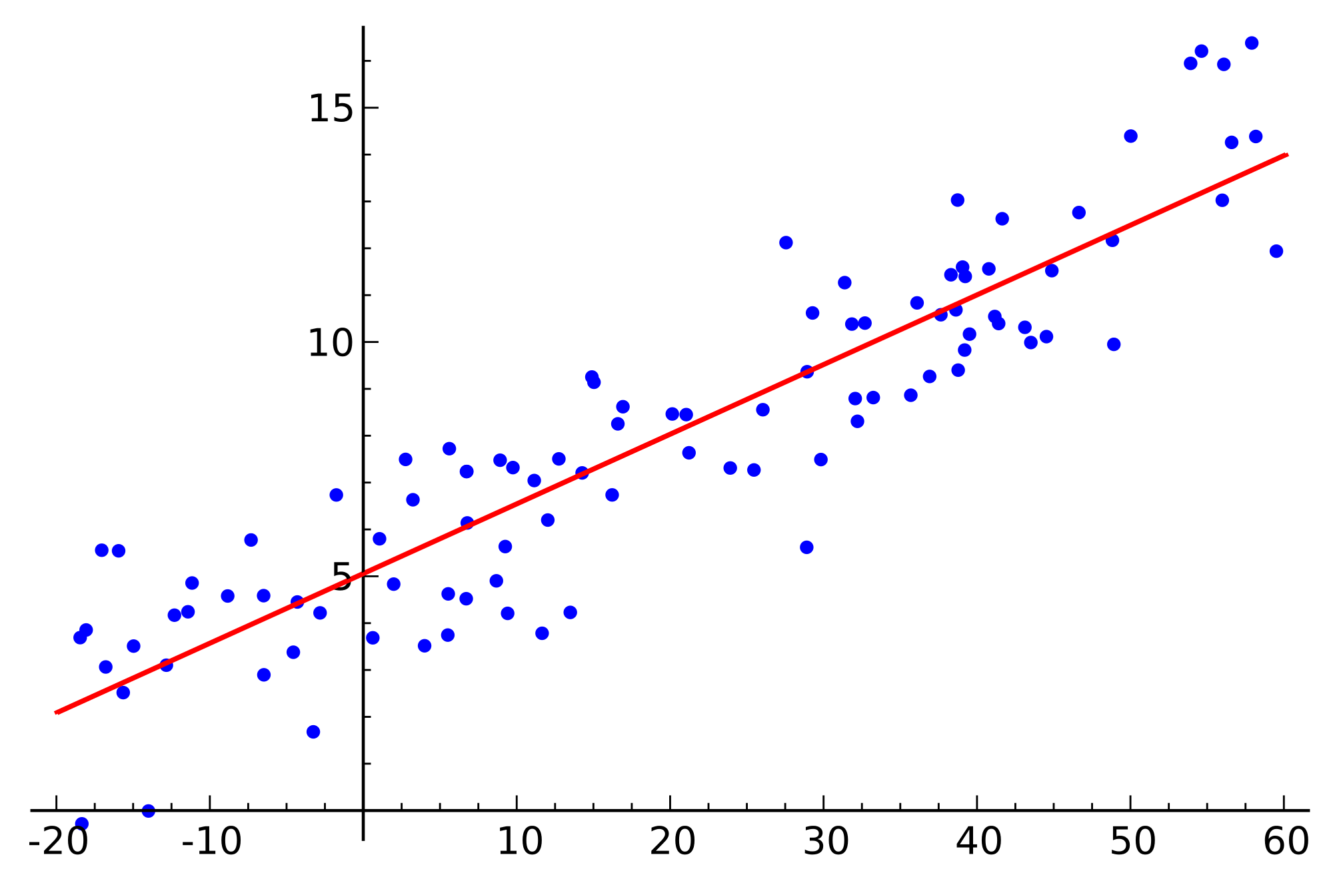

Linear Regression
$$y= θ_{0}+θ_{1}x$$
Notes:
Simple one

Slide 13
Machine Learning
Training Data
Features
Learn
Model
Predict
Features
Test Data
Label
Result

Slide 14
Model
perfection | 1.835453
good | 1.594106
imaginatively | 1.557151
elegance | 1.38889
flawless | 1.376564
hoot | 1.365043
masterful | 1.309927
anatomical | 1.309063
splendor | 1.298317
brilliant | 1.280205
last | -1.52705
insignificance | -1.53023
bad | -1.53766
hurts | -1.55874
out | -1.56803
subzero | -1.57245
disappointments | -1.59829
wastes | -1.62432
worthless | -1.67125
disappointment | -1.73917
Notes:
Simple one

Slide 15
Machine Learning
Training Data
Features
Learn
Model
Predict
Features
Test Data
Label
Result

Slide 16
3
Result

Slide 17
0.76527 The highest score
 | Unigram
Counts | 8000
Remove punctuation | O
Do stemming | O
Filter stopwords | X
Score | 0.59568
0.59568
0.51789 Benchmark

Slide 18
Future
POS
V
Adv
Adj
Prep
Conj
Interj
N
ProN
Use Part-of-Speech.
Give different weight.
Notes:
In the English language, words can be considered as the smallest elements that have distinctive meanings. Based on their use and functions, words are categorized into several types or parts of speech. This article will offer definitions and examples for the 8 major parts of speech in English grammar: noun, pronoun, verb, adverb, adjective, conjunction, preposition, and interjection.

Slide 19
Thank You!

